Slide 1

Generic birthday attack
Online Cryptography Course Dan Boneh
Collision resistance

Slide 2
Generic attack on C.R. functions
Let H: M → {0,1}^{n} be a hash function ( |M| >> 2^{n} )
Generic alg. to find a collision in time O(2^{n/2}) hashes
Algorithm:
Choose 2^{n/2} random messages in M: m₁, …, m₂n/2 (distinct w.h.p )
For i = 1, …, 2^{n/2} compute t_{i} = H(m_{i}) ∈{0,1}^{n}
Look for a collision (t_{i} = t_{j}). If not found, got back to step 1.
How well will this work?

Slide 3
The birthday paradox
Let r₁, …, r_{n} ∈ {1,…,B} be indep. identically distributed integers.
Thm: when n= 1.2 × B^{1/2} then Pr[ ∃i≠j: r_{i} = r_{j} ] ≥ ½
Proof: (for uniform indep. r₁, …, r_{n} )

Slide 4
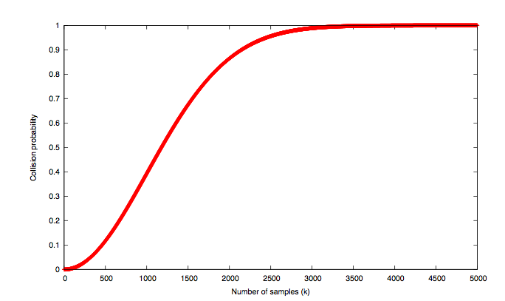
B=10⁶
# samples n

Slide 5
Generic attack
H: M → {0,1}^{n} . Collision finding algorithm:
Choose 2^{n/2} random elements in M: m₁, …, m₂n/2
For i = 1, …, 2^{n/2} compute t_{i} = H(m_{i}) ∈{0,1}^{n}
Look for a collision (t_{i} = t_{j}). If not found, got back to step 1.
Expected number of iteration ≈ 2
Running time: O(2^{n/2}) (space O(2^{n/2}) )
Notes:
m1 , … , m2^{n/2} are distinct with w.h.p

Slide 6
Sample C.R. hash functions: Crypto++ 5.6.0 [ Wei Dai ]
AMD Opteron, 2.2 GHz ( Linux)
digest generic
function size (bits) Speed (MB/sec) attack time
SHA-1 160 153 2⁸⁰
SHA-256 256 111 2¹²⁸
SHA-512 512 99 2²⁵⁶
Whirlpool 512 57 2²⁵⁶
NIST standards
* best known collision finder for SHA-1 requires 2⁵¹ hash evaluations

Slide 7
End of Segment

